Slide 1

Autumn term
Geography
Year 7 Geography Core Knowledge Booklet
Unit 1: Geographical Skills | G1 and G2
Unit 2: Climate change | C1 and C2
Unit 3: Development | D1, D2, D3, D4, D5, and D6

Slide 2
G1: Core knowledge
Question | Correct answer
What do geographers call a drawing of a particular area such as a city, a country or a continent represented on a flat surface? | map
2. What tool is used on a map to identify specific features or symbols? | a key
3. What scale map would display continents and oceans? | global
4. What type of maps could mountains appear on? | physical
5. What are the four compass directions on a four-point compass rose? | north, south, east, west
6. On an OS map, what are the numbers on the vertical axis called? | northings
7. On an OS map, what are the numbers on the horizontal axis called? | eastings
8. Why do OS maps have grid squares? | They allow you to identify a specific area on a map.
9. What is the main rule to remember when reading grid references? | Along the corridor and then up the stairs.
10. What are contour lines used for on 2D maps? | to show height of land

Slide 3
G2: Core knowledge
Question | Correct answer
Name the seven continents. | North America, South America, Asia, Africa, Europe, Antarctica, Oceania
2. Name the five oceans. | Atlantic, Pacific, Arctic, Southern, Indian
3. What is the capital of Scotland? | Edinburgh
4. What four countries make up the UK? | England, Scotland, Wales and Northern Ireland
5. Which ocean is between the UK and USA? | Atlantic
6. What are imaginary horizontal lines across the globe known as? | latitude
7. What are imaginary vertical lines across the globe known as? | longitude
8. Which two hemispheres does the equator separate? | northern and southern hemispheres
9. Is the equator a line of longitude or latitude? | latitude
10. Which two hemispheres does the prime meridian separate? | Eastern and Western Hemisphere

Slide 4
C1: Core knowledge
Question | Correct answer
1. Why are sea levels rising? | melting ice caps
2. Why do melting ice caps lead to sea level rise? | meltwater flows into oceans
3. What lines do climate zones roughly follow? | latitude
4. What system is used to identify climate zones globally? | Köppen climate system
5. What is the difference between climate zones and biomes? | Climate zones have the same climate. Biomes include climate and all the living and non-living things in the area.
6. What is the name of the collection of gases around the Earth? | the atmosphere
7. What are greenhouse gases? | gases, such as carbon dioxide, that trap heat within the atmosphere
8. What is the difference between the greenhouse effect and the enhanced greenhouse effect? | The greenhouse effect is natural, while the enhanced greenhouse effect is caused by an unnatural increase in greenhouse gases.
9. Why does the enhanced greenhouse effect occur? | more greenhouse gases
10. Which of these is a naturally occurring greenhouse gas in the atmosphere? | carbon dioxide

Slide 5
C2: Core knowledge
Question | Correct Answer
1. Is the greenhouse effect caused by humans? | No - its natural
2. Why do greenhouse gases increase global warming? | They trap thermal energy in the atmosphere.
3. Which human activities contribute to the enhanced greenhouse effect? | burning fossil fuels, transport, deforestation, waste disposal, agriculture
4. How does electricity generation contribute to the enhanced greenhouse effect? | Carbon dioxide is released when coal, oil and gas are burnt.
5. How does transport contribute to the enhanced greenhouse effect? | Carbon dioxide is released when petrol and diesel are burnt.
6. What is deforestation? | cutting down trees
7. How does deforestation contribute to the enhanced greenhouse effect? | Less carbon dioxide is absorbed from the atmosphere.
8. How does waste disposal contribute to the enhanced greenhouse effect? | Burnt or rotting waste releases greenhouse gases.
9. How does agriculture contribute to the enhanced greenhouse effect? | Animals like cows release greenhouse gases.
10. How does planting trees reduce the enhanced greenhouse effect? | more trees absorbing CO2

Slide 6
D1: Core knowledge
Question | Correct answer
1. Which term describes countries with lower standards of living, less advanced infrastructure and economies that are growing but not yet strong? | developing countries
2. Which term describes countries transitioning between developing and developed, showing rapid improvements in infrastructure? | emerging countries
3. The standard of living is often lower in…………countries than in emerging countries. | developing countries
4. Which term describes countries with high standards of living, advanced infrastructure and strong economies? | developed countries
5. The quality of healthcare is an example of which type of development factor? | social
6. The quality of education is an example of which type of development factor? | social
7. The quality of public transport is an example of which type of development factor? | economic
8. Income per person is an example of which type of development factor? | economic
9. The quality of infrastructure is an example of which type of development factor? | economic
10. Access to goods from other countries is an example of which types of development factor? | political and economic

Slide 7
D2: Core knowledge
Question | Correct answer
1. Which category of development does GNI per capita measure? | economic
2. What does per capita mean? | per person
3. What does GNI per capita tell geographers about a country? | average income per person
4. Why is GNI per capita a useful measurement of development? | It is not opinion-based.
5. What measurement is the Brandt Line based on? | GNI per capita
6. How does the Brandt Line categorise countries? | developed or developing
7. According to the Brandt Line, developed countries are in the… | global north
8. According to the Brandt Line, developing countries are in the… | global south
9. What is a major criticism of the Brandt Line? | oversimplifies development
10. Why do geographers argue that the Brandt Line is outdated? | It is based on data from 1980.

Slide 8
D3: Core knowledge
Question | Correct answer
1. What is the only category of development that the Brandt Line measures? | economic
2. How does the Brandt Line fail in representing current economic realities? | It ignores inequalities in countries.
3. What is the key term used to measure the percentage of people who can read and write? | literacy rate
4. Literacy rate is a measure of…………………development. | social - education
5. What is the key term used to measure the average number of years a person is expected to live? | life expectancy
6. Infant mortality rate is a measure of…………………development. | social - healthcare
7. The process by which money is collected to pay for services and infrastructure is known as… | taxation
8. Who are taxes paid to? | the government
9. Income tax is paid by… | individuals
10. VAT is paid by… | everybody that buys things

Slide 9
D4: Core knowledge
Question | Correct answer
1. Asia is the largest……………by land mass. | continent
2. What is the approximate population of Asia? | 4.6 billion
3. Asia is a continent made up of… | 48 different countries
4. The capital city of Nepal is… | Kathmandu
5. Kathmandu is known for its… | history and buildings
6. How would you describe the population distribution of Nepal’s capital city of Kathmandu? | densely populated
7. Nepal is surrounded by other countries. This means… | Nepal is landlocked.
8. In which category of human factors affecting development does ‘uneven distribution of income’ fit into? | economic
9. In which category of human factors affecting development does ‘corruption’ fit into? | political
10. In which category of human factors affecting development does ‘debt’ fit into? | economic

Slide 10
D5: Core knowledge
Question | Correct answer
If tourists travel to ‘take a break’, they are travelling for... | leisure
If tourists travel to see new sights, their primary purpose of travel is… | leisure
If tourists travel to attend a business meeting, they are travelling for... | business
If tourists travel to visit a famous historic monument, their primary purpose of travel is… | culture
If tourists travel to volunteer in a wildlife charity, this is known as... | ecotourism
If tourists travel to hike famous mountain trails, their primary purpose of travel is… | adventure
Africa is the second largest……………by land mass. | continent
What is the approximate population of Africa? | 1.4 billion
Africa is a continent made up of… | 54 different countries
The capital city of the DRC is… | Kinshasa

Slide 11
D6: Core knowledge
Question | Correct answer
Top-down development projects, decisions are made by…
2. Top-down development projects aim to improve…
3. Top- down development projects are funded by...
4. Top-down development projects are managed by…
5. Aid given over a prolonged period of time to support a country’s development is…
6. Which word describes a country that receives aid?
7. Which of these is not a type of long-term aid?
8. Long-term aid conservation projects increase…….. development.
9. Long-term aid supporting small businesses increases………..development.
10. Long-term aid education projects increase……..development.

Slide 12
D6: Core knowledge
Question | Correct answer
1. Top-down development projects, decisions are made by… | large organisations
2. Top-down development projects aim to improve… | infrastructure and services
3. Top- down development projects are funded by... | large organisations
4. Top-down development projects are managed by… | large organisations
5. Aid given over a prolonged period of time to support a country’s development is… | long-term aid
6. Which word describes a country that receives aid? | recipient
7. Which of these is not a type of long-term aid? | food parcels
8. Long-term aid conservation projects increase…….. development. | environmental
9. Long-term aid supporting small businesses increases………..development. | economic
10. Long-term aid education projects increase……..development. | social

Slide 13
Spring term
Geography
Geography Core Knowledge Booklet
Unit 4: Rivers | R1, R2, R3, R4, R5, and R6
Unit 5: World of Work | W1, W2, W3.

Slide 14
R1: Core knowledge
Question | Answer
1. Most water on Earth is…
2. Large masses of ice that fill valleys or the sides of mountains are…
3. The storage of water in the rock layer of the Earth is…
4. A large body of water in the rock layer is…
5. Water stored on the surface in lakes or puddles is…
6. The movement of water over the surface of the land back into a river is…
7. What term is used to describe the movement of water from the surface into the soil?
8. What term is used to describe the movement of water through the soil back into the river?
9. What do the numbers on contour lines measure?
10. When contour lines are close together, what does this show?

Slide 15
R1: Core knowledge
Question | Answer
1. Most water on Earth is… | salt water in oceans
2. Large masses of ice that fill valleys or the sides of mountains are… | glaciers
3. The storage of water in the rock layer of the Earth is… | groundwater
4. A large body of water in the rock layer is… | aquifer
5. Water stored on the surface in lakes or puddles is… | surface storage
6. The movement of water over the surface of the land back into a river is… | surface run-off
7. What term is used to describe the movement of water from the surface into the soil? | infiltration
8. What term is used to describe the movement of water through the soil back into the river? | throughflow
9. What do the numbers on contour lines measure? | the height above sea level in metres
10. When contour lines are close together, what does this show? | steep sloping land

Slide 16
R2: Core knowledge
Question | Correct answer
1. Where in the drainage basin is the land likely to be flatter? | near the mouth
2. Which feature would you find in the upper course? | waterfalls
3. What is the channel like in the upper course? | narrow and shallow
4. How steep is the land in the upper course? | steep
5. Which type of erosion is most common in the upper course? | vertical erosion
6. Which feature would you find in the middle course? | meander
7. What is the channel like in the middle course? | wider and deeper than the upper course
8. How steep is the land in the middle course? | less steep
9. Which type of erosion is most common in the middle course? | lateral erosion
10. Which feature would you find in the lower course? | mouth

Slide 17
R3: Core knowledge
Question | Correct answer
1. What is the channel like in the lower course? | very wide and deep
2. How steep is the land in the lower course? | flat
3. Which type of erosion is most common in the lower course? | lateral erosion
4. Which type of transportation involves medium-sized pebbles and stones being bounced along the riverbed? | saltation
5. Which type of transportation involves large, heavy boulders and rocks being rolled along the riverbed? | traction
6. Which type of transportation involves fine, light material being carried along in the water? | suspension
7. Which type of transportation involves material being dissolved in the river? | solution
8. Waterfalls form when hard rock sits above… | soft rock
9. Why does soft rock wear down more quickly than hard rock? | It is less resistant to erosion.
10. The soft rock erodes, leaving a gap under the hard rock, which is called a… | plunge pool

Slide 18
R4: Core knowledge
Question | Correct answer
1. The hard rock on top has nothing to support it; this is called… | undercutting
2. Unsupported hard rock is known as the… | overhang
3. Unsupported hard rock collapses into the… | plunge pool
4. Waterfalls move backwards as overhanging hard rock collapses; this process is known as… | retreat
5. The waterfall moves upstream, leaving a steep-sided… | gorge
6. Where on the meander is the river current fastest? | outside bend
7. What is the process acting upon the riverbank on the outside bend? | erosion
8. Which river process occurs in low energy environments? | deposition
9. What is formed by deposition on the inside bend of a river? | slip-off slope
10. What are meanders? | bends in a river

Slide 19
R5: Core knowledge
Question | Correct answer
1. Where on the meander is the river current slowest? | inside bend
2. What type of erosion involves the river moving across the land? | lateral erosion
3. Which course of the river are floodplains and levees found in? | the lower course
4. Which river process is responsible for the formation of floodplains and levees? | deposition
5. Heavy material builds up in layers on the riverbanks, creating… | levees
6. Levees are made from a build-up of… | sediment
7. What is the sediment transported by a river collectively known as? | river load
8. The finest material the river is carrying is transported in… | suspension and solution
9. During a flooding event, the material the river is carrying is... | deposited on the land
10. The heaviest material the river has transported is deposited… | closest to the riverbanks

Slide 20
R6: Core knowledge
Question | Correct answer
1. To help pay for the damage caused by flooding, homes and businesses have… | insurance
2. Where are the impacts of flooding often more severe? | in remote areas of some countries
3. What strategy of flood management involves blocking part of the river channel? | a dam
4. What strategy of flood management involves removing sediment from the bed of the river to make it deeper? | dredging
5. What strategy of flood management involves planting trees to increase interception? | afforestation
6. What strategy of flood management involves measuring changes in the river flow? | monitoring and prediction
7. What continent is Bangladesh in? | Asia
8. What is the capital of Bangladesh? | Dhaka
9. Bangladesh is located at the …………… of the Ganges and Brahmaputra rivers. | mouth
10. Bangladesh meets the ……………… to the south. | Bay of Bengal

Slide 21
W1: Core knowledge
Question | Answer
1. Which employment industry does farming fit into? | primary industry
2. Which employment industry does dentistry fit into? | tertiary industry
3. Which employment industry does mining fit into? | primary industry
4. Which employment industry does building design fit into? | quaternary industry
5. Which employment industry does shoe making fit into? | secondary industry
6. Which employment industry does an electrician fit into? | tertiary industry
7. Which employment industry does car manufacturing fit into? | secondary industry
8. Which employment industry does an astronaut fit into? | quaternary industry
9. What is the term for machines doing the jobs that once required humans? | mechanisation
10. Which industry were most jobs available in during the industrial revolution? | secondary industry

Slide 22
W2: Core knowledge
Question | Answer
1. How does technology affect the production of goods and services? | It makes it easier and cheaper.
2. In which sectors are fewer jobs needed when the UK imports more goods from other countries due to increased trade? | primary and secondary industries
3. What sectors do high levels of education in the UK create opportunities for people to work in? | A wide variety of jobs.
4. Why are there now more jobs in shops, entertainment, leisure and tourism in the UK? | Higher disposable income.
5. What is the term for services provided using tax earnings for healthcare, education and policing? | public services
6. In which sectors could people find more jobs when they moved from rural areas to towns and cities? | schools, hospitals and shops
7. Most people in the UK work in… | service sector jobs
8. The amount of people working in each industry across the UK is… | Affected by the human and physical features of each area.
9. Where is the number of people working in the quaternary sector greatest? | urban areas than rural areas
10. Where is the number of people working in the primary sector greatest? | rural areas than urban areas

Slide 23
W3: Core knowledge
Question | Answer
1. Why are large factories more common on the edges of towns and cities? | They need good transport links to move goods.
2. In areas with large tourist industries, many people work in… | restaurants, hotels, shops and entertainment
3. Tax earnings from businesses and workers can be spent on public services, what sort of impact does this have? | social and economic impact
4. How do industries affect people, the economy and the environment? | positively and negatively
5. Industries can affect the migration paths of wildlife, what sort of impact is this? | environmental impact
6. Industries can create new technologies and products which make people’s lives better, what sort of impact is this? | social impact
7. Is the abundance of natural resources a human or physical factor? | physical
8. Is infrastructure for trade a human or physical factor? | human
9. Is the availability of machinery a human or physical factor? | human
10. Is soil fertility a human or physical factor? | physical

Slide 24
Summer term
Geography
Geography Core Knowledge Booklet
Unit 5: World of Work | W4 and W5.
Unit 6: The Middle East | M1, M2, M3 and M4.

Slide 25
W4: Core knowledge
Question | Answer
1. What effect do trade blocs have on trade for participating countries? | They make trade easier.
2. What do trade blocs allow participating countries to do? | Work closely together.
3. What effect do tariffs have on trade? | They make trade more expensive.
4. What is one way in which tariffs are used by countries? | Encourage people to buy things made in that country.
5. How does access to good quality transport infrastructure affect trade? | Reducing the time and cost of moving goods.
6. How does good communication infrastructure affect trade? | Allowing things to be bought and sold quickly and effectively.
7. How does challenging relief affect trade? | Increasing transport costs and making road building difficult.
8. Why might landlocked countries find trading goods more difficult? | Goods may need to pass through other countries to reach a port.
9. Countries with a large primary sector are likely to… | Export more raw materials which have a lower value.
10. How can money earnt from exporting goods and services helps countries develop? | Money can be spent on education, infrastructure and innovation.

Slide 26
W5: Core knowledge
Question | Answer
1. What hemisphere is Russia in? | northern
2. How many time zones does Russia span? | 11
3. Where in Russia do the majority of the population live? | European Russia
4. How is the population of Russia distributed? | unevenly
5. Which area of Russia has the harsher climate? | Siberia
6. Which area of Russia has the lowest relief? | European Russia
7. Which employment sector do most people in Russia work in? | tertiary
8. What is Russia’s biggest export? | fossil fuels
9. Typically, emerging countries have larger… | manufacturing sectors
10. Typically, developing countries have larger… | agricultural sectors

Slide 27
M1: Core knowledge
Question | Answer
1. The Middle East is made up of… | Different countries in the same region.
2. Which of these countries is not in The Middle East? | India
3. Which of these countries is in the region of The Middle East and the continent of Africa? | Egypt
4. Most countries in the region of The Middle East are located in… | Southwest Asia
5. What is a colony? | A country that is controlled by another.
6. The British, French, Roman, Early Islamic, Ottoman and Ancient Egyptian ……………….. have impacted countries in The Middle East. | empires
7. What is the largest climate zone in The Middle East? | hot desert
8. What is the highest point in The Middle East? | Mount Damavand
9. What is the longest river in The Middle East (and world)? | The River Nile
10. Where is the fertile crescent located? | Area between the Nile, Tigris and Euphrates rivers.

Slide 28
M2: Core knowledge
Question | Answer
1. Many countries in The Middle East have large reserves of… | fossil fuels
2. The area of The Middle East covered by the Arabian Desert can be described as… | densely populated
3. What aspect of Istanbul’s history has shaped its identity as a hub, connecting Europe and Asia? | trade
4. Which human feature in Jordan is important for representing cultural heritage and ancient civilisations in The Middle East? | Petra
5. Why is the Suez Canal important for Egypt and the world? | access for trade
6. Which of these is a non-renewable source of energy? | natural gas
7. Which words can be used to describe non-renewable sources of energy? | finite and not sustainable
8. Which area of The Middle East has the largest reserves of crude oil? | The Persian Gulf
9. How is crude oil in the Earth’s crust accessed? | drilling
10. What is the process of removing or obtaining something from a source? | extraction

Slide 29
M3: Core knowledge
Question | Answer
1. Crude oil is versatile meaning… | It has many uses.
2. Which fuels are created using crude oil? | petrol and diesel
3. Which process involves changing crude oil into useful components? | refining
4. Which of these is a primary use of crude oil? | refining into plastic
5. What's the name for the process of getting fossil fuels from The Middle East to different places around the world? | the supply chain
6. A person or company that buys something to use is referred to as a… | consumer
7. A person or company making goods or services for sale is referred to as a… | producer
8. The amount of something producers are willing to sell is the… | supply
9.The supply of fossil fuels is… | naturally limited
10. The amount of something consumers are willing to buy is the… | demand

Slide 30
M4: Core knowledge
Question | Answer
1. What is the most southerly country in The Middle East? | Yemen
2. Which of these seas and gulfs does NOT border Yemen? | Persian Gulf
3. Yemen is part of the Arabian… | peninsula
4. Which body of water is found to the west of Yemen? | Red Sea
5. Which country is north of Yemen? | Saudi Arabia
6. What is the largest climate zone in The Middle East? | hot desert
7. What is the highest point in The Middle East? | Mount Damavand
8. What is the longest river in The Middle East (and world)? | The River Nile
9. GNI per capita is used as an indicator of ………………… development. | economic
10. Life expectancy indicates the level of ……………… in a country. | healthcare

Slide 31
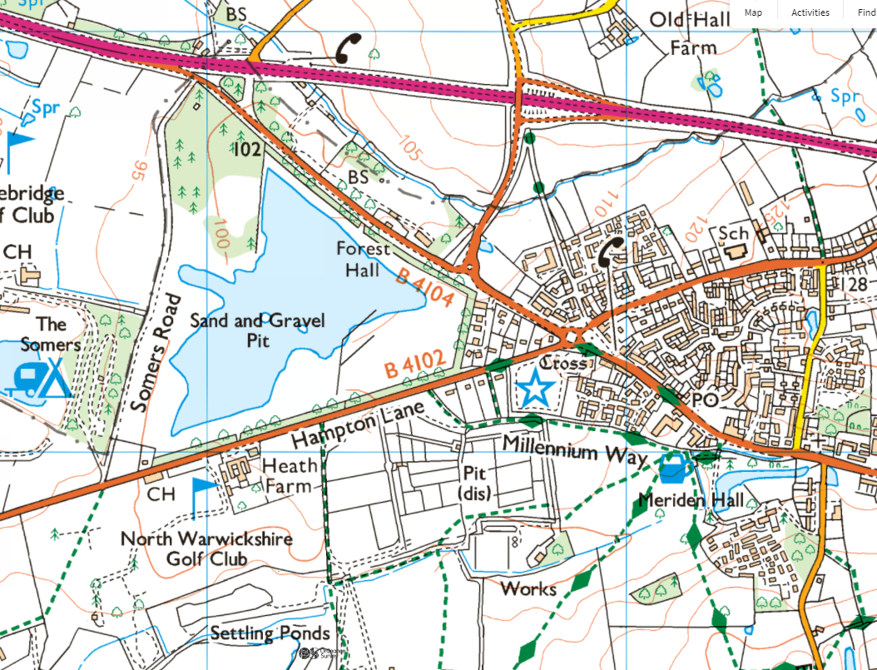
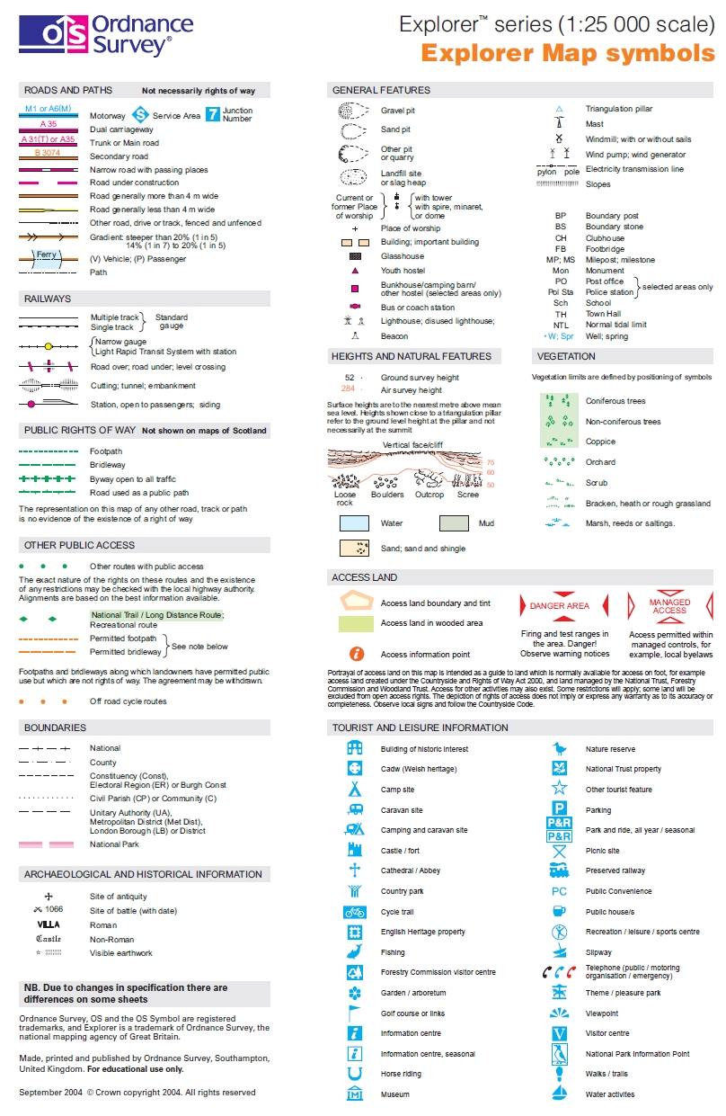
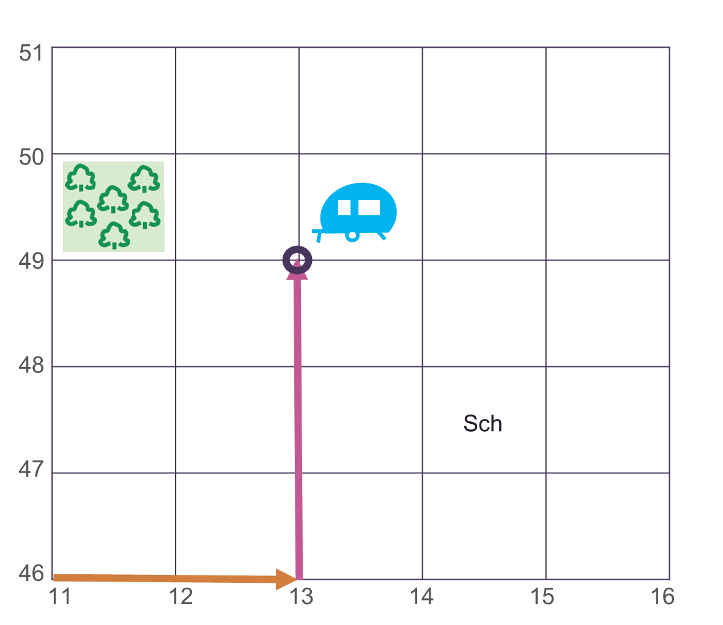
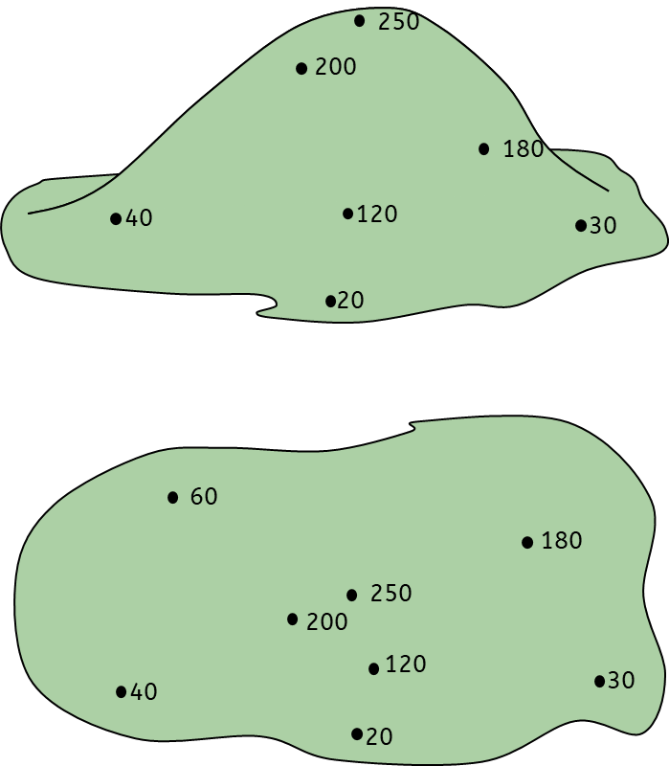
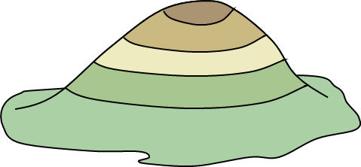
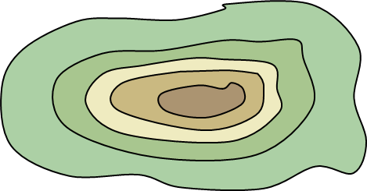

7.01 Introduction to geographical skills
1. Maps and symbols
OS maps use symbols to show human and physical features. Maps have a title, labels, a compass rose, a scale and a key.
3.Four-figure grid references
Four-figure grid references are used to describe locations on an OS map.
Look at the bottom-left corner of the square.
Find the easting.
Find the northing.
Write down the four-figure grid reference.
2. Key vocabulary
4. Relief
Continent – One of the seven large land masses on Earth
Longitude – The lines down the earth showing east or west
Latitude – The lines across the earth showing north and south
Eastings – The grid reference along the bottom
Northings – The grid reference up the side
Contour lines – Brown lines on a map that show height
Relief – The height of the land
Topography - The shape and physical features of an area
Altitude - Height above sea level (measured in metres).
OS map – Ordnance Survey is a map of areas of the UK
Height on a 2D map can be shown using three methods:
Spot heights – a dot giving the exact height of a specific point.
Colour layering - different heights are shown by bands of different colours.
Contour lines – brown lines connecting areas of the same height.
Geography | 7.01 – Introduction to map skills | Knowledge Organiser
Notes:
Images
Scale (CCO) - https://commons.wikimedia.org/wiki/File:Scale_kilometres_miles.svg
OS map data (© Crown copyright ) - https://explore.osmaps.com/location?lat=52.438393&lon=-1.659061&zoom=14.5560&style=Leisure&type=2d&locationName=U2FsdGVkX1%2BUlocJejMa8nY7mBPU9MrKluCg3%2BPBUcQ%3D&locationCoordinates=-0.6098437645336163%2C52.459120647858285&locationBbox=-0.6199%2C52.4517%2C-0.6008%2C52.4638
All other images – United Learning

Slide 32


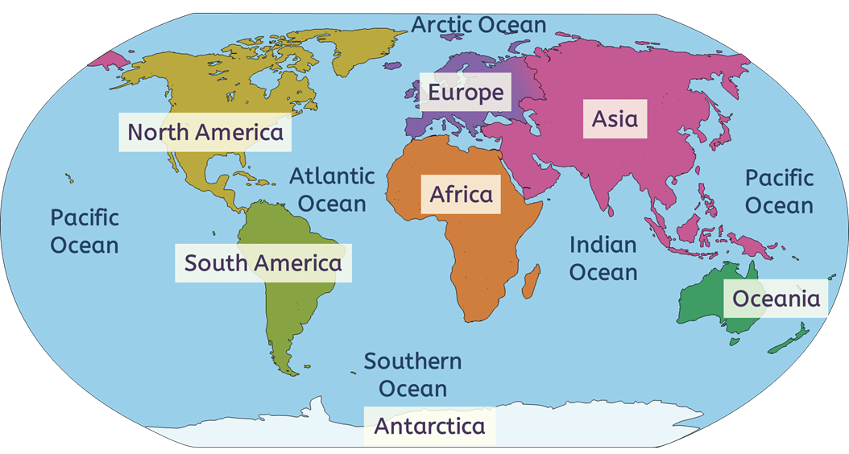
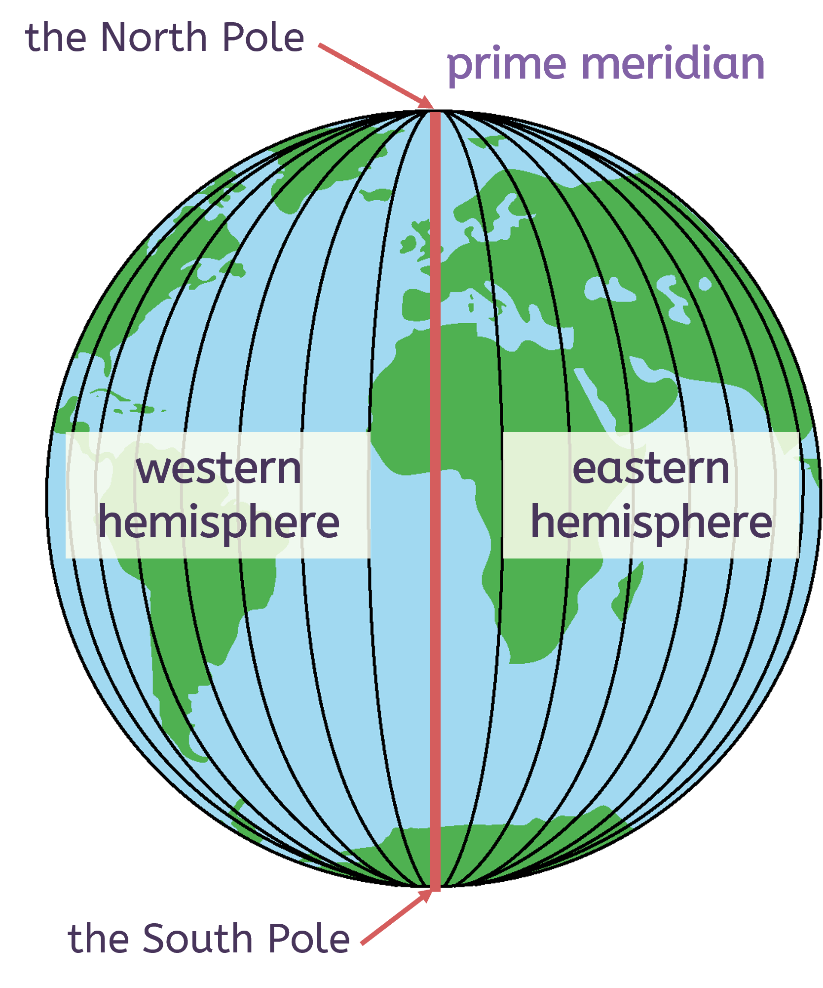
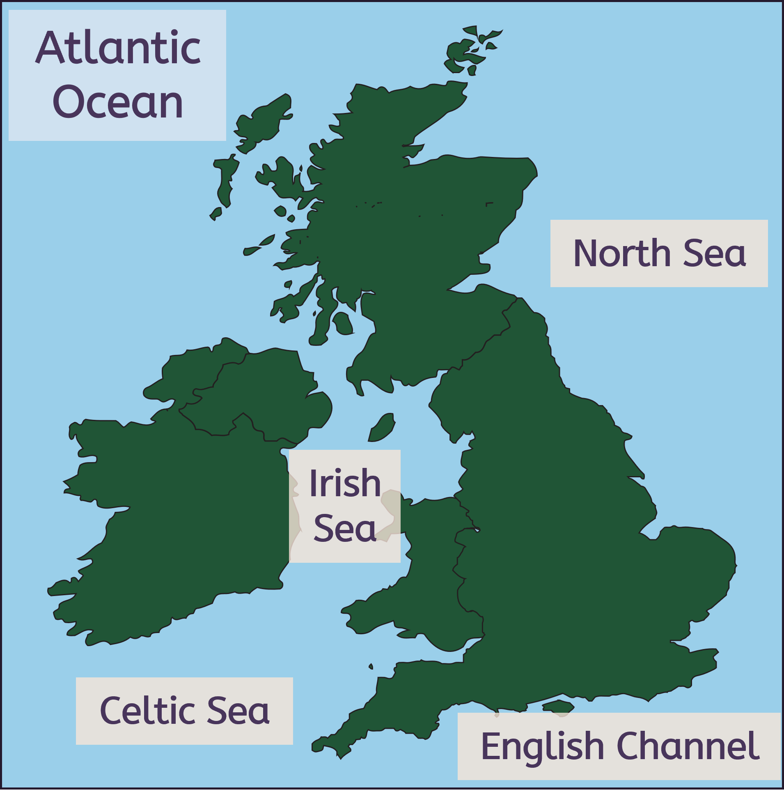
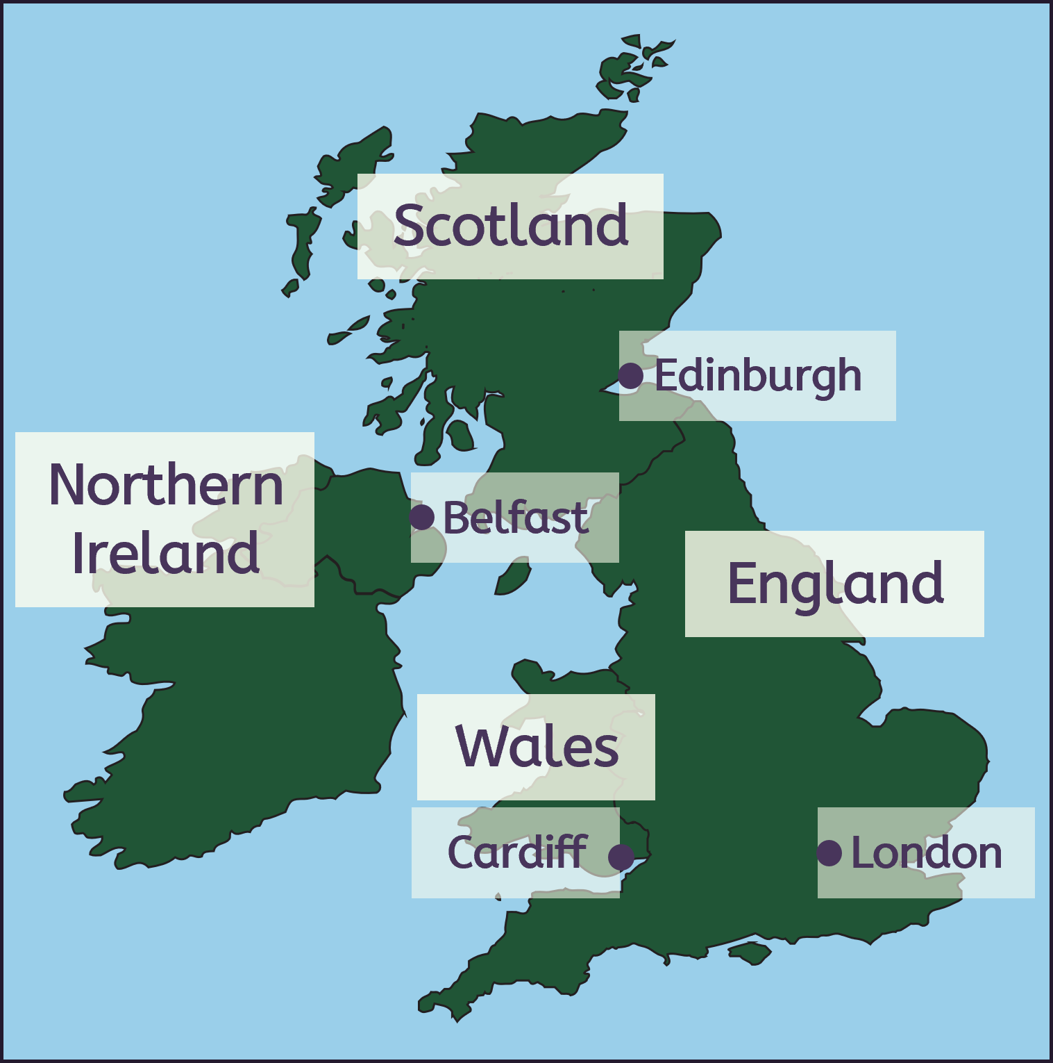
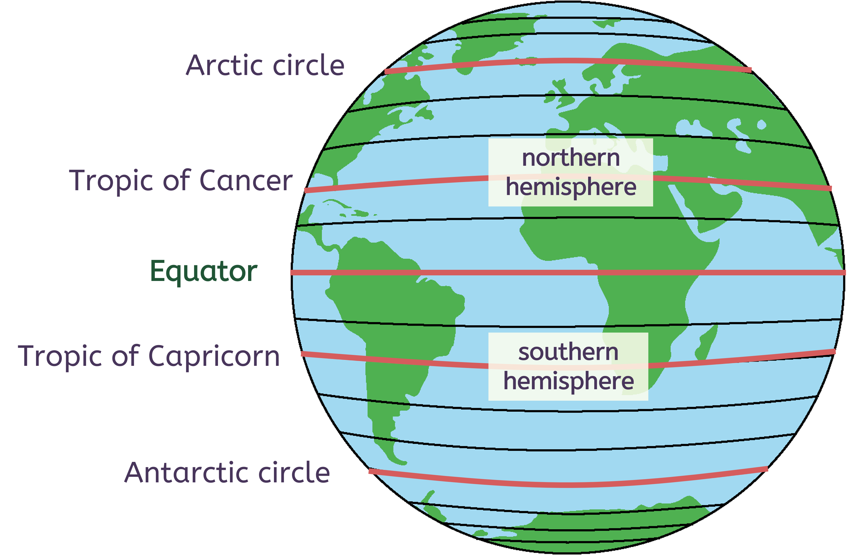
7.01 Introduction to geographical skills
6.Compass
North
Northwest
Northeast
5.Continents, oceans and countries in the UK
West
East
Southwest
Southeast
South
7.Longitude and latitude
Longitude
Latitude
Notes:
Images
All images – United Learning

Slide 33
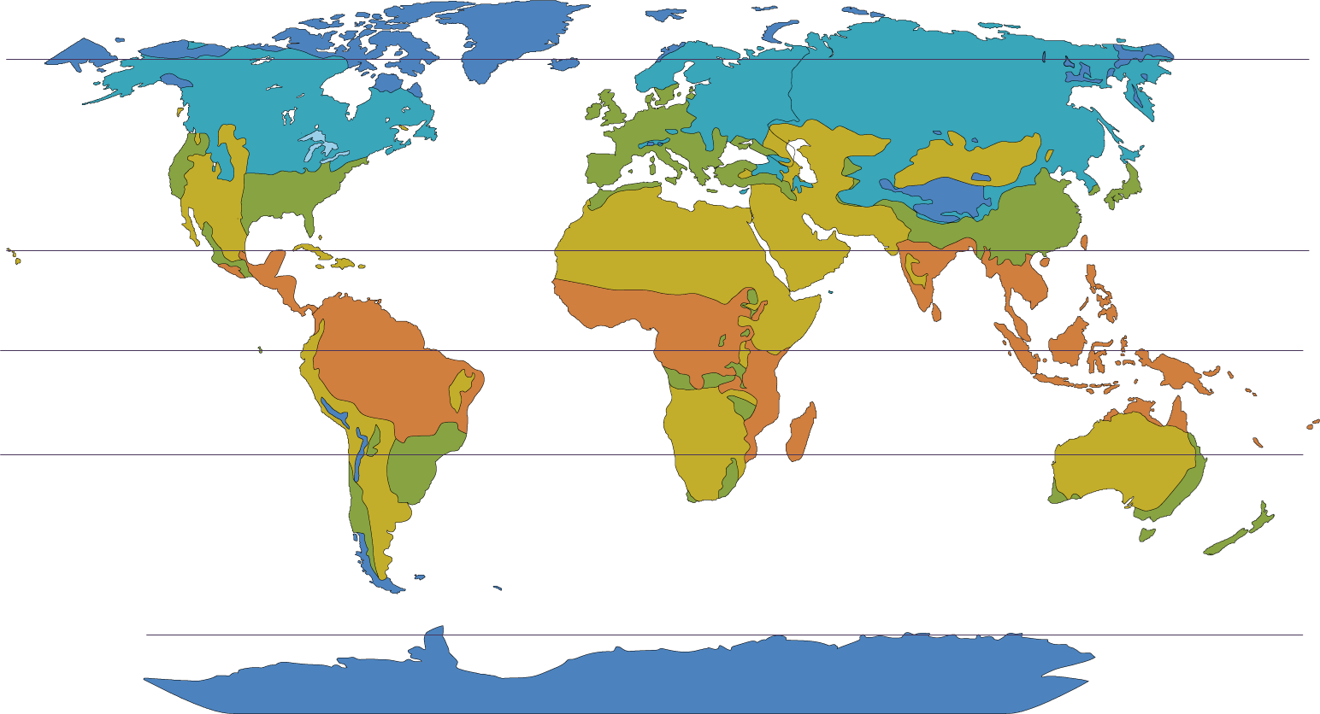
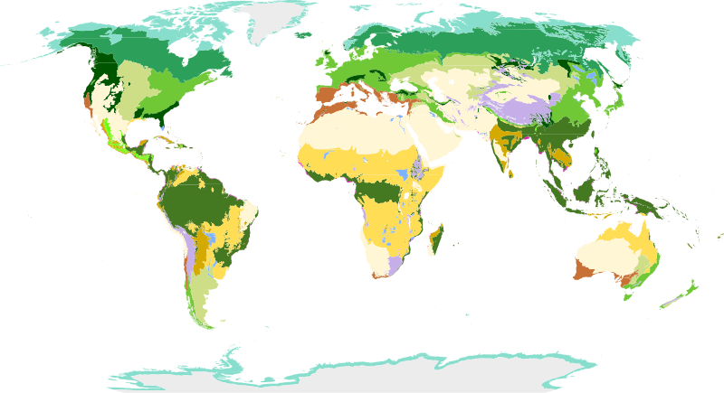
7.02 Introduction to global climate
1. Climate zones
3. Key Vocabulary
Climate zones are areas in the world that have a similar climate. There are several major climate zones in the world, and the main six are shown on this map. The climate zones generally group together horizontally, following lines of latitude.
greenhouse gases – gases such as carbon dioxide that trap heat within the atmosphere
the greenhouse effect – the natural warming of the planet to its habitable temperature, caused by trapping heat in the Earth’s atmosphere
the enhanced greenhouse effect – the unnatural warming of the Earth due to increased greenhouse gases in the atmosphere
global warming – the increase of average temperatures on Earth; this happens naturally but happens faster due to the enhanced greenhouse effect
climate change – the change in the Earth’s long-term weather patterns, including precipitation, wind and temperature
fossil fuel – a (chemical) store of energy formed over millions of years from dead plants and animals
tropical A
arid (dry) B
temperate C
continental D
polar E
2. Biomes
 | tundra
 | taiga
 | temperate forest
 | tropical rainforest
 | savanna grasslands
 | Mediterranean
 | hot deserts
 | cold deserts
 | alpine shrublands
Biomes are areas of the world that, because of similar climates, have similar landscapes and wildlife. Biomes are shown on the map.
Terpsichores, CC BY-SA 3.0,via Wikimedia Commons
Geography | 7.01: Introduction to map skills | Knowledge Organiser
Notes:
Images:
Biomes of the world (CC BY-SA 3.0) – https://commons.wikimedia.org/wiki/File:Biomes_of_the_world.svg
All other images – United Learning

Slide 34
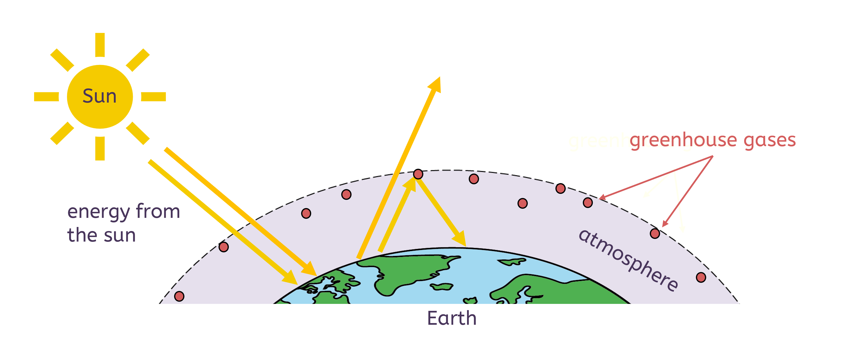
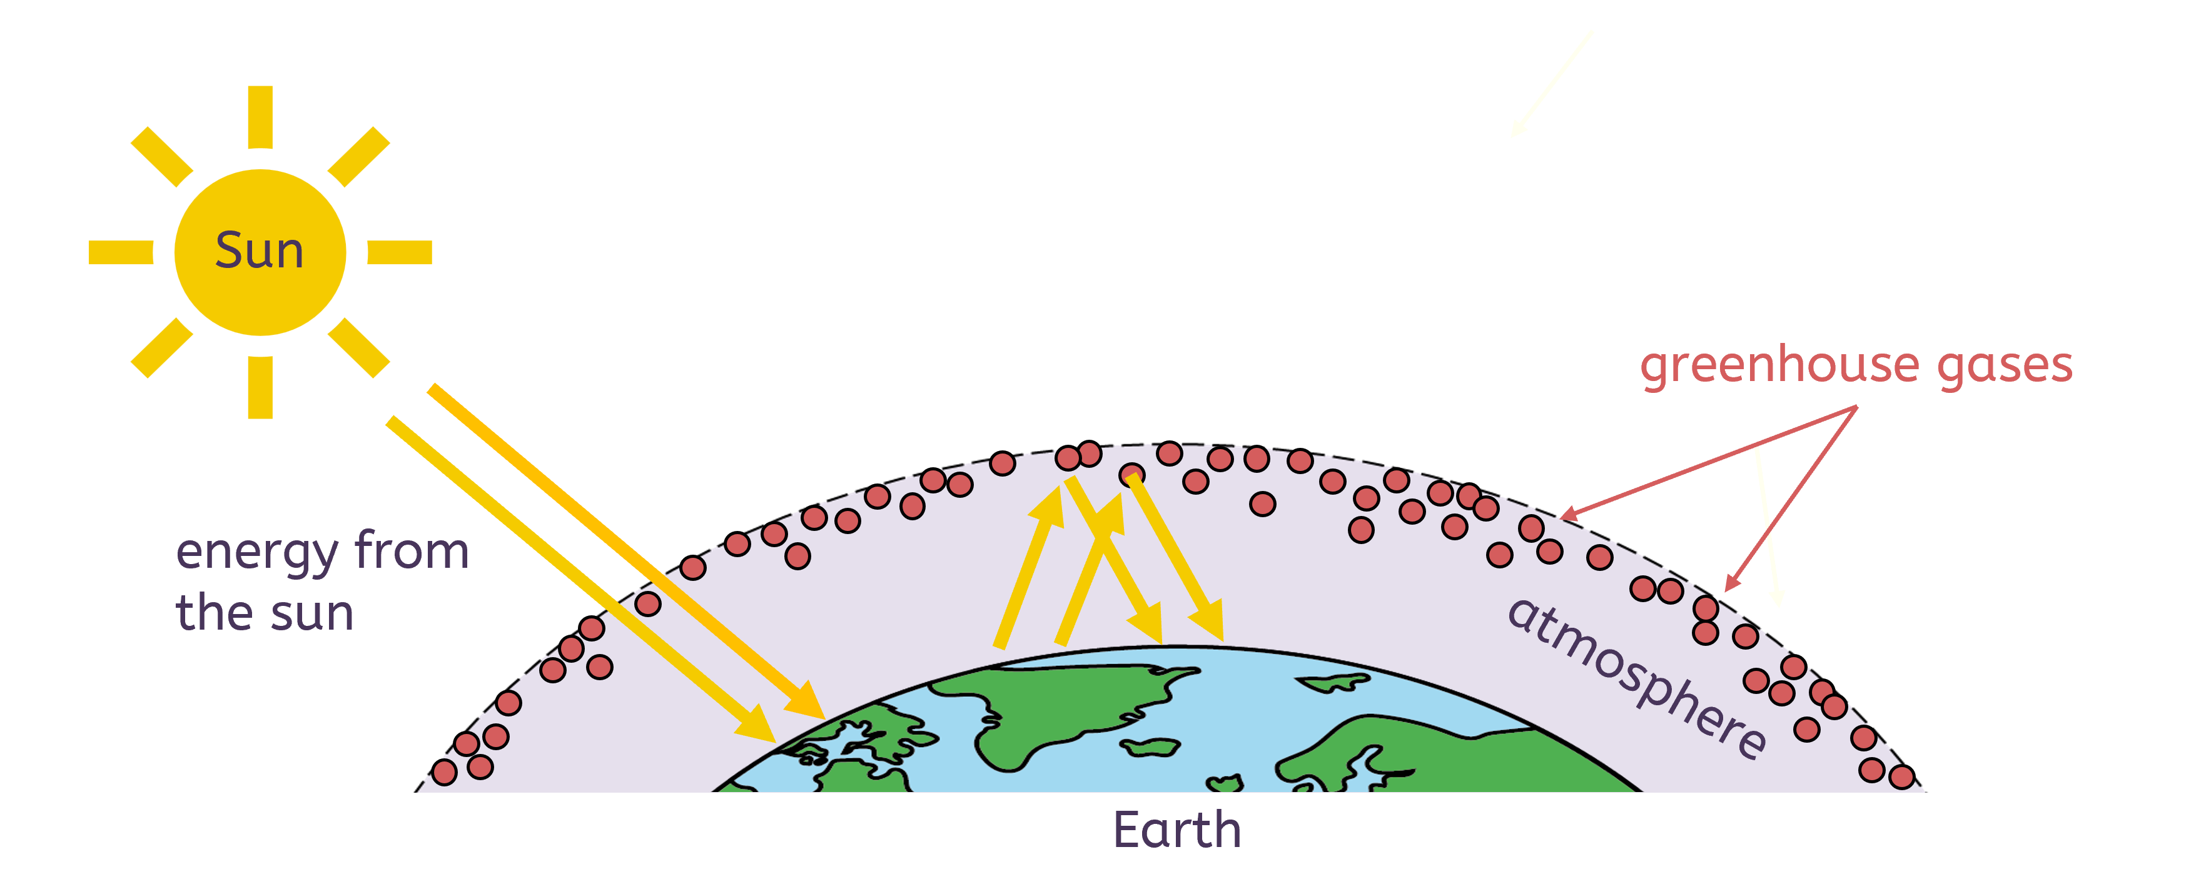
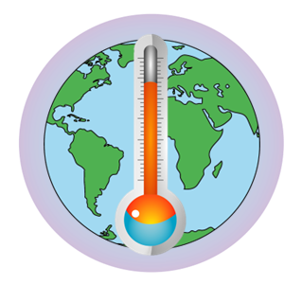
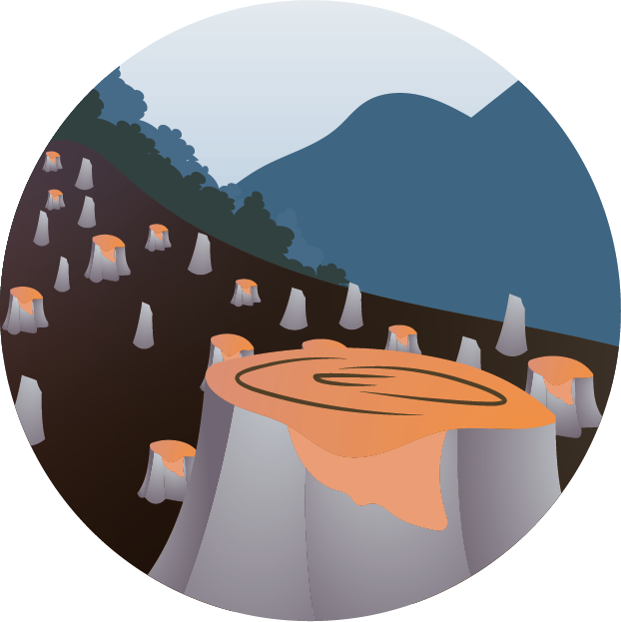
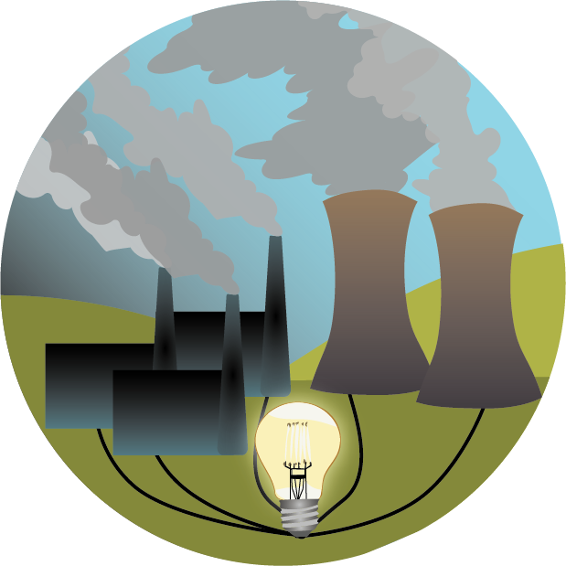


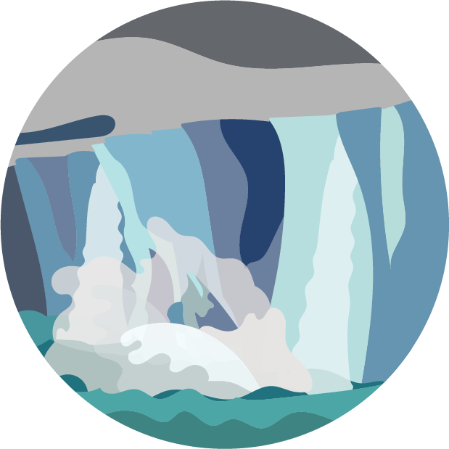


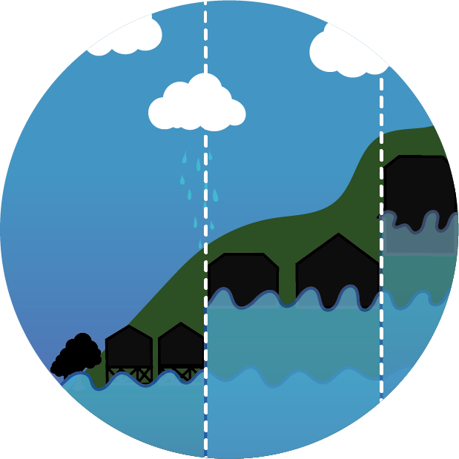
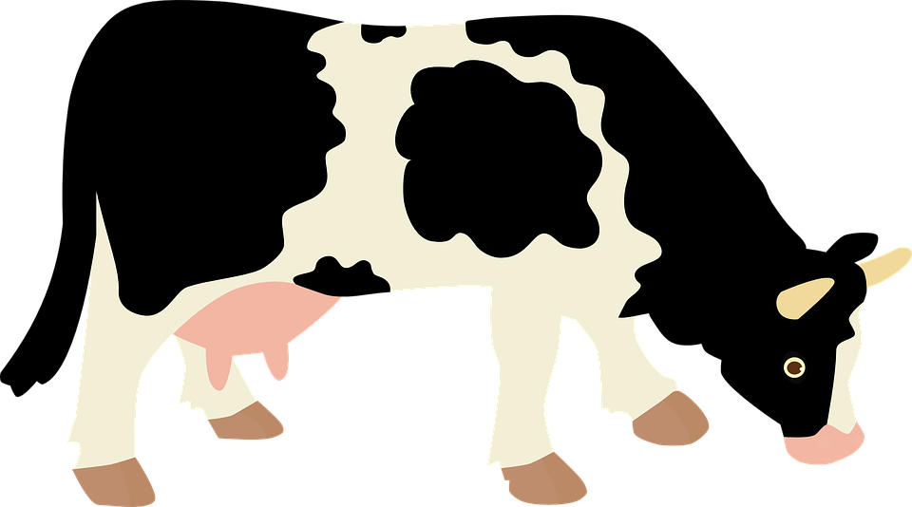
7.02 Introduction to global climate
4. Global warming
The greenhouse effect is the natural process, which has always taken place, that keeps the Earth warm. Without it, the Earth would be too cold to live on.
The light and heat energy are trapped in the atmosphere by greenhouse gases, such as carbon dioxide. This warms the Earth.
The enhanced greenhouse effect causes an unnatural increase in temperature. Human activities (such as burning fossil fuels, transport, waste, agriculture, deforestation) increase the amount of greenhouse gases in the atmosphere. The Earth warms more quickly, and global warming increases.
Accelerated global warming can also lead to other changes in the Earth’s long-term weather patterns, such as precipitation, wind and storms. The changes to the Earth’s wider climate – not just temperature – are called climate change.
5. The causes of climate change
6.The effects of climate change
Climate change is caused by:
burning fossil fuels for transport and electricity generation, which releases greenhouse gases
deforestation, which reduces the absorption of greenhouse gases
agriculture and waste disposal, which release greenhouse gases
Climate change can cause:
more extreme weather events, such as heatwaves
melting sea ice and ice caps
rising sea levels and flooding of coastal areas
deforestation
electricity generation
transport
agriculture
waste
Notes:
Images:
Cows (CC0) – from https://pixabay.com/vectors/cow-milk-tour-economy-animal-1204968/
All other images – United Learning

Slide 35



7.03: Development
1. Background
3. Measuring development
Across the world, the standard of living and quality of life can be very different.
A | Countries therefore have different classifications based on the quality of life within them.
B | How developed a country is can be measured in different ways.
C | Development levels can vary within and between countries. There are many reasons why some countries are more developed than others.
D,E | Countries can become more developed in many ways, including through economic growth from tourism, top-down development projects and bottom-up development projects.
1 | GNI per capita | (n) the average income of a country's citizens.
2 | infant mortality rate | (n) the number of babies that do not survive to one year old per 1,000 births.
3 | life expectancy | (n) the average number of years a person is expected to live.
4 | literacy rate | (n) the percentage of people in a specific age group, typically aged 15 and above, who can read and write.
5 | average years of schooling | (n) the average number of years of education that individuals aged 25 and older have completed.
6 | Human Development Index (HDI) | (n) a composite measure of development that is used to categorise the development of countries using GNI per capita, life expectancy and average years of schooling.
5. Development Projects
D) Top-down project: The Grand Inga Dam DRC
Advantages | Disadvantages
It provides a reliable source of renewable energy for the DRC. | It would flood 22,000 hectares of land in the Bundi Valley.
It provides electricity for Kinshasa at a lost cost. | Natural habitats will be destroyed by the reservoir.
It produces electricity that the DRC can sell the other countries. | 35,000 people would be displaced from their homes by the dam reservoir.
It produces electricity to power more coltan and copper mines. | Electricity will be sold to other countries, and many people in rural DRC will still be without electricity.
2. Country classification
4. Factors that hinder development
E) Bottom-up project: WECAN DRC
Advantages | Disadvantages
It protects the habitats of 100,000 species of animals and plants. | It is small scale, so it has limited reach.
It empowers indigenous women. | It does not stop illegal logging.
Women earn money from selling fruit and herbs from the trees planted. | The project currently supports only 700 women.
It reduces the impact of climate change through reforestation. | It takes a long time for the full benefits to be achieved.
1 | developed | (n) countries with high standards of living, advanced infrastructure and strong economies.
2 | emerging | (n) countries transitioning between developing and developed, showing rapid improvements in infrastructure.
3 | developing | (n) countries with lower standards of living, less advanced infrastructure and economies that are growing but not yet strong.
Human | Physical
uneven distribution of income | challenging relief
corruption | extreme climate
conflict | lack of natural resources
low-value goods and services for trade | landlocked
high levels of debt | tectonic hazards
poor education systems | extreme weather
poor healthcare systems | lack of water resources
Geography | 7.03 – Development | Knowledge Organiser
Notes:
Images:
All images – United Learning

Slide 36


7.04 Rivers
3. The river profile
1 | upper course | the narrow, steep, upper part of a river, which contains waterfalls
2 | middle course | the wider, deeper channel, which contains meanders and oxbow lakes
3 | lower course | the widest, flattest part of the river near the mouth, which contains the floodplain.
1. Background
7. River features - floodplains
Rivers affect the landscape and the lives of the people who live near them.
A | Rivers are found within their own drainage basin and have their own distinct features.
B | As a river moves from its source in the upper course to its mouth in the lower course, its profile changes.
C | There are many different river processes that can impact the landscape.
D–F | The processes of erosion and deposition can lead to the formation of different river landforms.
G | Flooding is a key feature of rivers, and drainage basin processes play a significant role in this. By altering the drainage basin of a river, we can interfere with these processes.
H | There are many examples of floods. Today, many strategies have been put in place to manage the flood risk.
1 | floodplain | (n) a wide, flat area of land that is flooded frequently when a river bursts its banks (lower course)
2 | levee | (n) banks found at the side of a river in the lower course
3 | silt | (n) the fine, fertile eroded material transported by a river
4. River processes
 | river load | (n) the material carried along in the river
1 | erosion | (n) the breaking down or wearing away of material.
vertical erosion |  | (n) erosion which takes place downwards into the land.
lateral erosion |  | (n) when erosion moves across the land from side to side, causing the bends of meanders to widen.
2 | transportation | (n) when rivers carry rocks and sediment along their journey
3 | deposition | (n) when a river drops its load
8. The drainage basin system
1 | precipitation | (n) water falling to the ground in all forms (rain, snow, sleet and hail)
2 | interception | (n) when the leaves of trees stop precipitation reaching the ground
3 | surface runoff | (n) the movement of water over the surface of the land back into a river
4 | surface storage | (n) water stored on the surface in lakes or puddles
5 | infiltration | (n) the movement of water from the surface into the soil
6 | throughflow | (n) the movement of water through the soil back into the river
5. River features - waterfalls
1 | waterfalls | (n) water falling from a height when a river or stream flows over a steep drop (upper course)
2 | plunge pool | (n) an area at the base of a waterfall that undercuts the hard rock layer
3 | gorge | (n) a steep sided valley left behind when a waterfall retreats upstream
9. Case study: Somerset levels UK
2. Drainage basin features
Where/when | Southwest England, flood 2014 Rivers Parrett and Tone
Causes | Effects | Responses
deforestation on the floodplain | 600 homes flooded | 20,000 sandbags provided to protect homes
saturated ground from heavy rainfall | £200 million lost from the collapse of the tourist industry | 65 pumps installed to drain millions of cubic metres of floodwater
low-lying land with four rivers flowing through it | 6,800 hectares of agricultural land flooded | Hundreds of people were evacuated from their homes.
build-up of sediment in the channel from lack of dredging | Native bird species couldn’t hunt on the flooded ground. | The Environmental Agency is spending £6 million a year on dredging the rivers Parrett and Tone.
1 | drainage basin | (n) an area of land drained by a river and its tributaries
2 | source | (n) the start of a river
3 | mouth | (n) the place where the river enters a lake, sea or ocean
4 | tributary | (n) a smaller river that joins a larger river
5 | confluence | (n) the point at which two or more rivers meet
6 | watershed | (n) the dividing line between two drainage basins
6. River features - meanders
1 | meander | (n) a bend in a river (middle course)
2 | slip-off slope | (n) the sloping bend of a meander from the inside (shallow) to the outside (deep)
3 | river cliff | (n) the undercut bank on the outside bend of a meander
Geography | 7.04 – Development | Knowledge Organiser
Notes:
Images:
All Other images – United Learning

Slide 37

7.05: World of work
6. Employment structures and development
Countries | Industries
developing countries | Large primary sector, growing secondary sector and a moderate tertiary sector.
emerging countries | large secondary sector, rapidly falling primary sector and growing tertiary sector.
developed countries | A large tertiary sector, a growing quaternary sector, both secondary and primary employment is low.
1. Background
3. Influences on employment structures
A | The world of work can be classified into four different employment sectors.
B | Many factors influence the type of employment sector which will be found within a particular country.
C | Industrial location is influenced by some key factors, which are more important for some industries in comparison to others.
D | Employment structure within countries varies based upon the level of development.
E | Trade, imports and exports.
F | Employment sectors and impact of industry in Russia.
1 | industrialisation | (n) a move from primary employment to secondary employment, with a rise in manufacturing.
2 | mechanisation | (n) when machinery begins to do the jobs which once required humans.
3 | disposable income | (n) the money a person has left to spend after they have paid all their bills.
4 | public services | (n) a service that is given or funded for the benefit of the community.
Change | Cause
Falling primary and secondary sector | 1. Cheaper to import. 2. Mechanisation has taken jobs. 3. Raw materials have been exhausted in certain areas.
Growing tertiary sector | 1. Disposable income has increased, so a greater demand for services. 2. A large public sector e.g. health and education, due to a high tax revenue.
4. The location of industries
1 | site | (n) the actual place where a settlement first grew up. This refers mainly to its physical setting.
2 | situation | (n) the location of a place relative to other features nearby.
3 | footloose | (adj) industries which are not tied to a specific location and can operate from anywhere.
4 | raw materials | (n) natural resources that are used to make other things.
5 | labour | (n) workers, employed people.
6 | market | (n) a place where things are bought and sold.
2. Employment sectors
1 | employment | (n) when people are in work, receiving a wage and paying tax.
2 | unemploy-ment | (n) when people are not in work, therefore do not receive a wage and do not pay tax.
3 | primary industries | (n) industries which collect or extract natural resources from the environment, such as farming or fishing.
4 | secondary industries | (n) industries which manufacture goods into products, such as builders, car manufacturers or food processing
5 | tertiary industries | (n) industries that provide a service, such as teachers, doctors, sales, hairdressers or bus drivers.
6 | quaternary industries | (n) industries that involve using technology, design and research, including computer scientists, game designers, computer engineers and research scientists.
7. Case study: World of work in Russia
Factors effecting trade in Russia
Opportunities | Challenges
With a working population of over 75 million people, Russia has one of the largest workforces in the world. | Russia is at war with Ukraine which affects international relationships.
The Steppe and temperate woodlands of western Russia are fertile and flat. | Russia has the largest land mass of any country.
Russia has an extensive network of roads, railways, ports and pipelines. | Russia does not have a warm water port.
Russia has vast reserves of natural resources including oil and natural gas. | Many countries aim to buy and use less oil and natural gas in the future to mitigate the effects of climate change.
Russia’s education system puts a strong focus on science, technology, engineering and maths (STEM).
5. Trade
1 | trade | (n) the exchange of goods and materials between countries.
2 | import | (v) goods brought into a country.
3 | export | (v) sending goods to another country for sale.
4 | trade bloc | (n) an arrangement in which participant countries lower trade barriers with one another.
5 | tariff | (n) a tax imposed on goods when they are imported or exported between countries.
Geography | 7.05: World of work | Knowledge Organiser
Notes:
Images:
All images – United Learning

Slide 38

7.06: The Geography of The Middle East
5. Case study: Diversification in Saudi Arabia
1. Background
3. Natural resources in The Middle East
1 | diversify | (v) to vary in order to spread the risk or expand.
2 | single major industry | (n) a significant portion of a country's economic activity is concentrated within a specific sector.
3 | stakeholder | (n) a person who has an interest in something or who is affected by something.
4 | climate change | (n) the changes in the Earth’s long-term weather patterns, which is being sped up due to global warming.
A | The Middle East is a region that covers western Asia, parts of northern Africa and south-eastern Europe.
B | The Middle East has huge reserves of natural resources.
C | Trade in the Middle East is heavily influenced by the region's vast oil and natural gas reserves, making it a critical part of global energy markets.
D | Saudi Arabia: Some countries in the Middle East are trying to diversify their economies.
E | Yemen: Development can vary between countries within The Middle East.
1 | fossil fuel | (n) a natural fuel such as coal or gas. Formed from the remains of living organisms in the geological past.
2 | non-renewable | (n) energy which is finite, not sustainable, and takes a long time to replenish.
3 | refined | (n) separating and purifying different components of crude oil to produce useful products.
4 | extraction | (n) the act of taking something from the ground.
5 | crude oil | (n) naturally occurring, unrefined petroleum that can be refined into diesel, petrol etc.
6 | energy | (n) a source of usable power.
7 | supply | (n) the amount of something producers are willing to sell at a certain price.
8 | demand | (n) the amount of something consumers are willing to buy at a certain price.
9 | sustainability | (n) meeting the needs of today, while making sure we can meet the needs of the future.
Factors influencing diversification and development
Diversification in Saudi Arabia | Development in Yemen
the demand for natural resources | famine
the supply of natural resources | infrastructure
switch to renewable energy sources | conflict and corruption
religious pilgrimage | water scarcity
opportunities for tourism | trade
2. Features of The Middle East
1 | region | (n) a large area with common physical or human characteristics.
2 | population distribution | (n) how people are spread out over an area.
3 | fertile soil | (n) soil rich in nutrients.
4 | natural resource | (n) a useful thing or material that is found in nature, such as food, water or wood.
5 | colonialism | (n) acquiring control over another country, occupying it with settlers and sometimes exploiting it economically.
6 | plain | (n) a broad, flat or gently rolling land area with minimal variation in terrain.
7 | peninsula | (n) a landform surrounded by water on three sides but connected to a larger landmass on one side.
8 | wadi | (n) a dry riverbed or valley, typically found in arid or semi-arid regions.
6. Case study: Development in Yemen
1 | developed countries | (n) countries with high standards of living, advanced infrastructure and strong economies.
2 | developing countries | (n) countries with lower standards of living, less advanced infrastructure and economies that are growing but not yet strong.
3 | borders | (n) a real or artificial line that separates geographic areas.
4 | corruption | (n) the misuse of power for private gain.
5 | civil war | (n) war between citizens of the same country.
6 | humanitarian crisis | (n) an event or events that threaten the health, safety or wellbeing of a large group of people.
7 | Sykes-Picot agreement | (n) a secret 1916 agreement between the United Kingdom and France to divide up parts of the Middle East for themselves.
8 | infrastructure | (n) the basic structure or features of an area or system e.g. roads, schools, hospitals and electric connectivity.
4. Trade
1 | trade | (n) the exchange of goods and materials between countries.
2 | import | (v) goods brought into a country.
3 | export | (v) sending goods to another country for sale.
4 | trade route | (n) a passage of travel used by traders, either on land or in the sea.
Geography | 7.06: The Geography of The Middle East| Knowledge Organiser
Notes:
Images:
All images – United Learning

